Slide 1
ShapeUp
Fitness
By Team 2- Bug Squashers

Slide 2
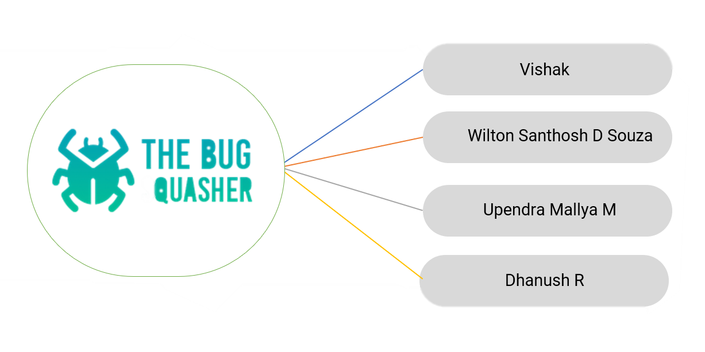
Team 2 (The Bug Squashers)

Slide 3
Table of contents
01
Introduction
02
Technologies
03
Architecture
04
Demo
05
Learning & Future Scope

Slide 4
01
Introduction

Slide 5
The Idea
Most of the users have to use multiple apps to track their fitness activity, do workout, exercises. People loose interest after a while as they find it very cumbersome to use different apps and keep track of it.
People are becoming more and more health-conscious, but they don’t find enough time to go to a gym or even workout at their homes dedicatedly.
ShapeUp is a fitness app that aims to keep you fit and healthy and make your lifestyle healthier by tracking your workout pattern everyday.
The purpose of this app is to provide the user with instructions and examples of one or more types of exercise, physical activity, or some other fitness topic.

Slide 6
Benefits
Monitor Your Progress
Give Free Health and Fitness Tips
Track Your Foot Steps
All In One Health Tool
Keep You Motivated

Slide 7

Technologies

Slide 8






Slide 9
03
Architecture

Slide 10
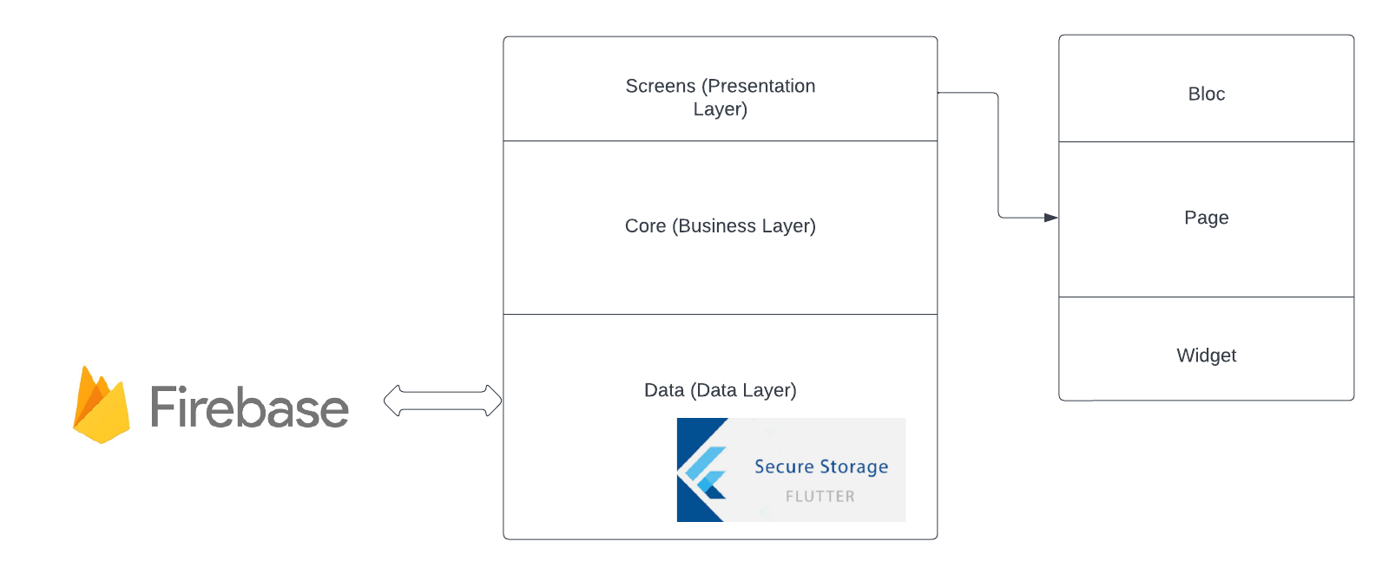

Slide 11
04
Demo

Slide 12
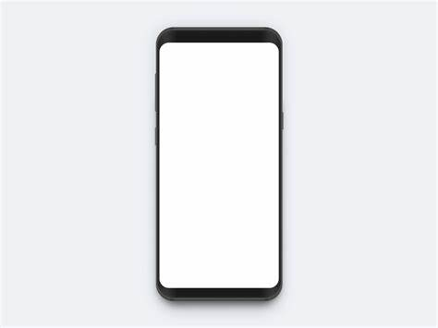
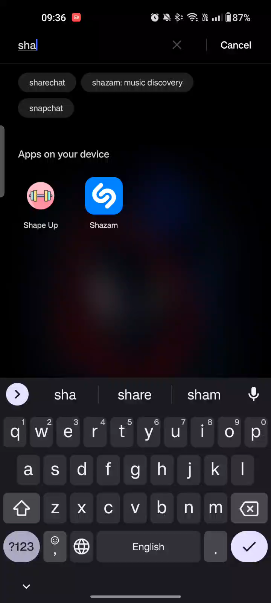

Slide 13
Future Scope

Slide 14
Future Scope
Learnings
To structure the code and making it more well documented
Knowledge on Flutter and Firebase
Collaboration in Github
Diet Plans
Steps Count
Integration with Smart Devices
Integration with Health Care

Slide 15
Thank You

